Slide 1
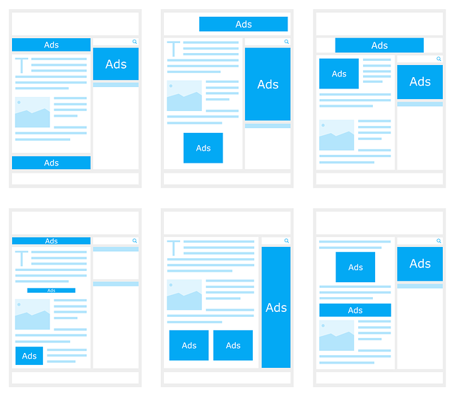
Is It Worth Investing in Advertisement?
A Presentation by Rahul Adwani
INSAID - March 2020 Cohort

Slide 2

Project Objective
Building ML block of a system which can predict if investing in an advertisement will give us a positive netgain or not based on the given data

Slide 3


Agenda
Data Snapshot
Data Exploration
Data Preprocessing
Machine Learning & Model Evaluation
References

Slide 4
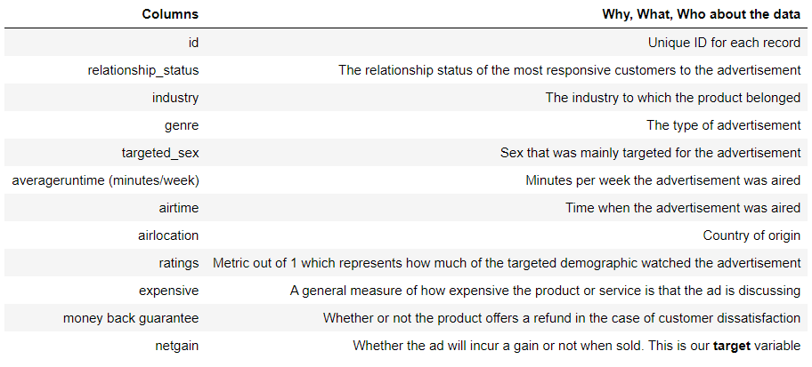
Data Snapshot

Slide 5

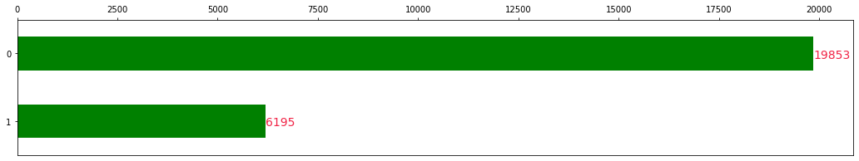
Data Exploration - Label
Out of 26048 samples
19853 - Netgain = 0
6195 - Netgain = 1
We have sufficient representation from the positive class

Slide 6
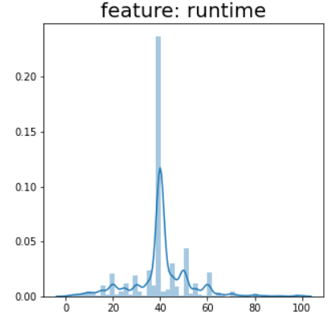
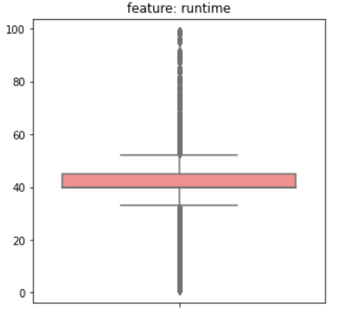
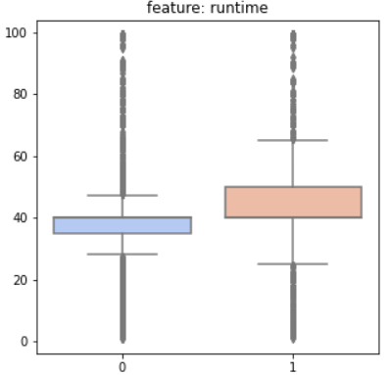
Data Exploration – Continuous Features
Two continuous features in the dataset - ratings and runtime
Dropped ratings. Why?
About runtime:
Distribution, Outliers, Frequency Distribution wrt Label

Slide 7
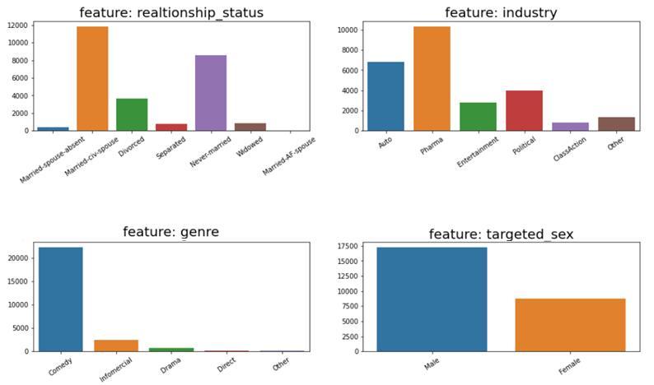
Data Exploration – Categorical Features

Slide 8
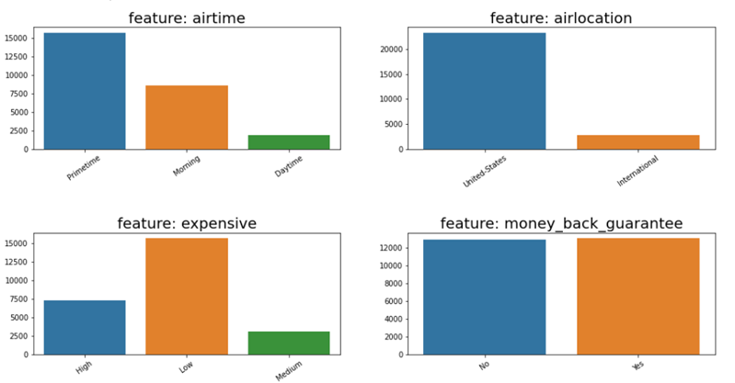
Data Exploration – Categorical Features

Slide 9
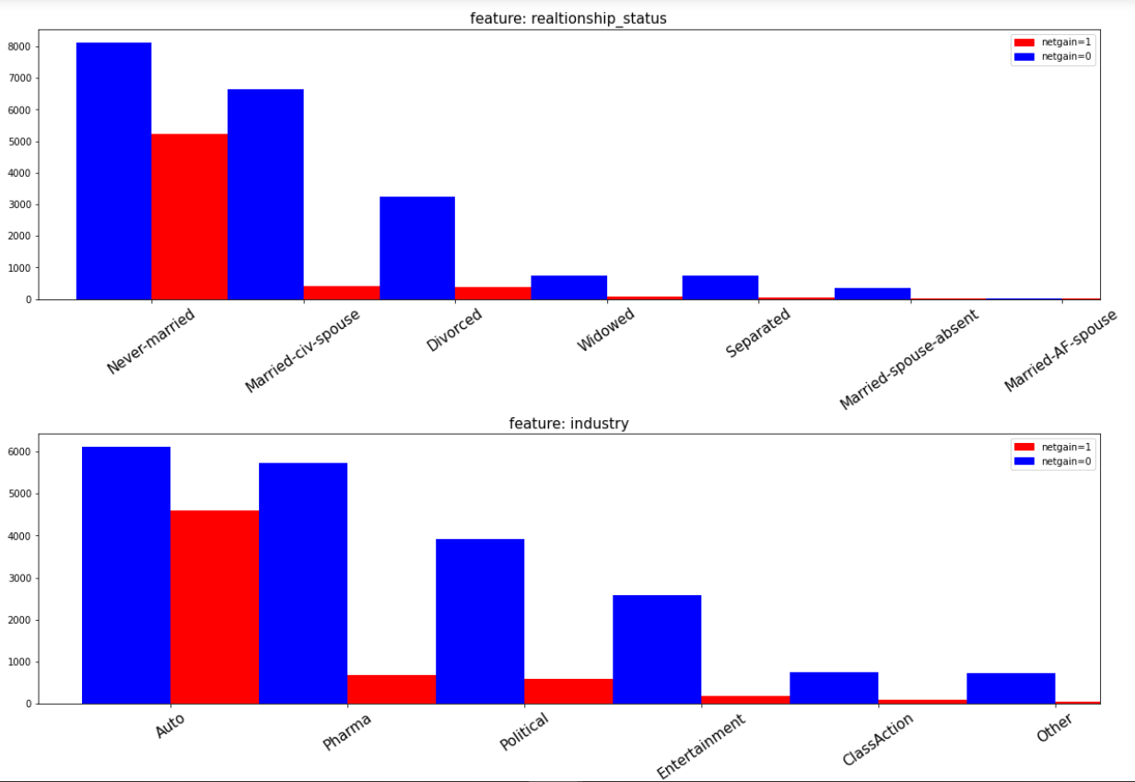
Data Exploration – Categorical Features

Slide 10
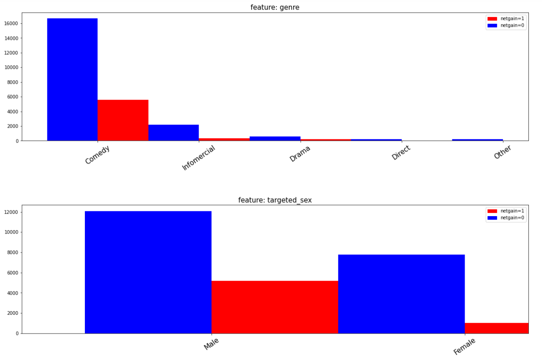
Data Exploration – Categorical Features

Slide 11
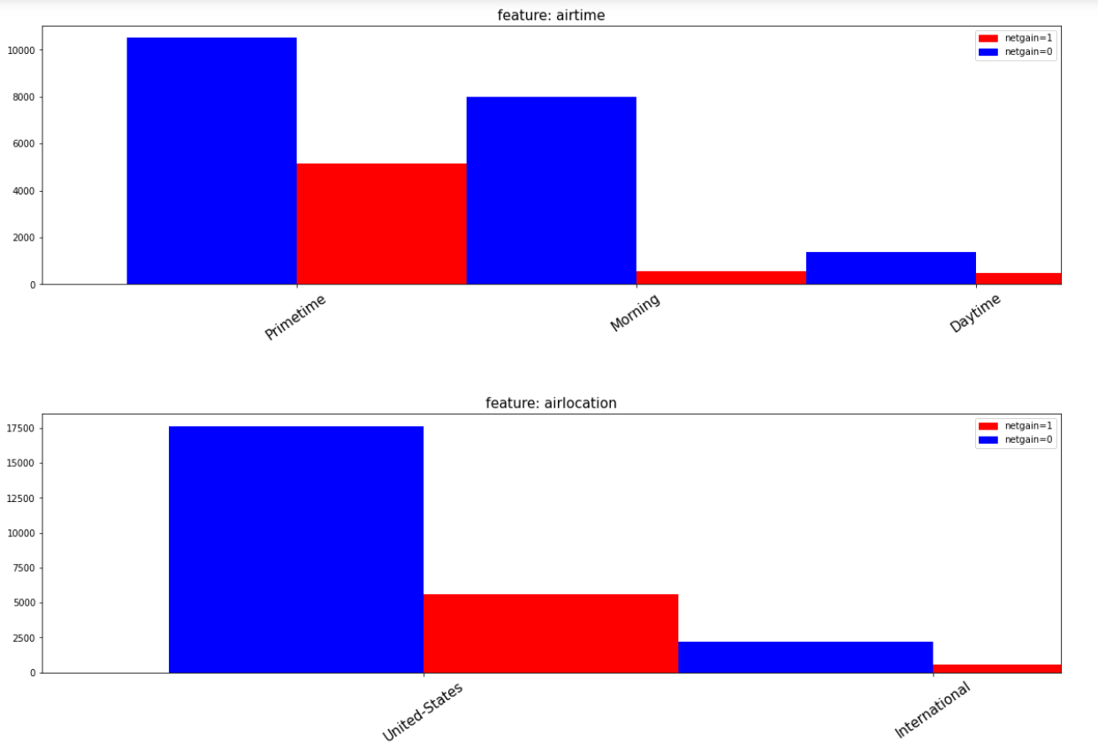
Data Exploration – Categorical Features

Slide 12
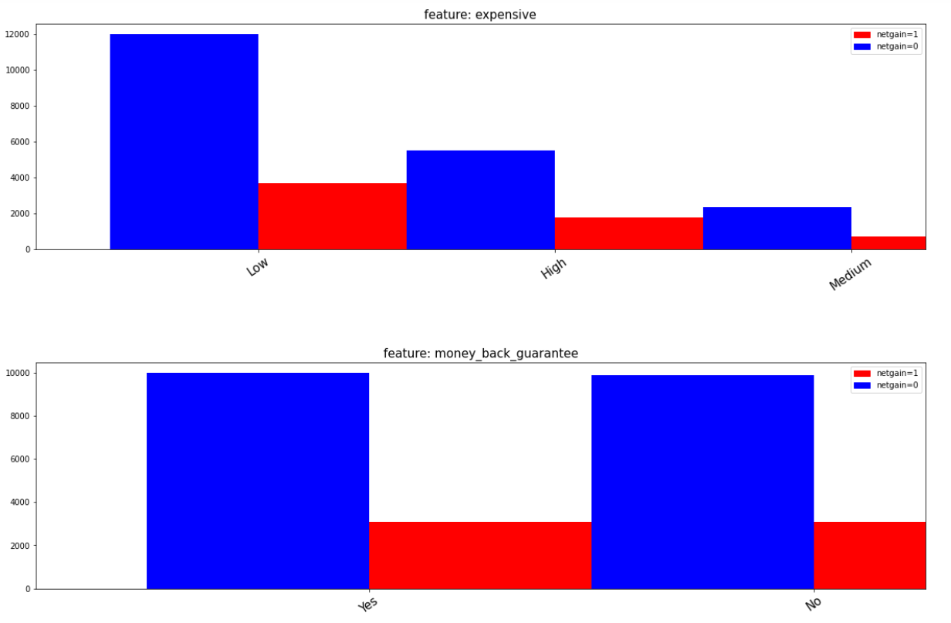
Data Exploration – Categorical Features

Slide 13
Data Preprocessing
Handling Missing & Erroneous Values
No missing or erroneous values present in the data
Encoding
One Hot Encoding for all the categorical features
Handling Label Class Imbalance
Not Required
Handling Outliers in Features
Isolation Forest - Significant Impact
Data Scaling
Standard Scaling
Feature Selection
Standard Deviation Rule
Principal Components Analysis

Slide 14
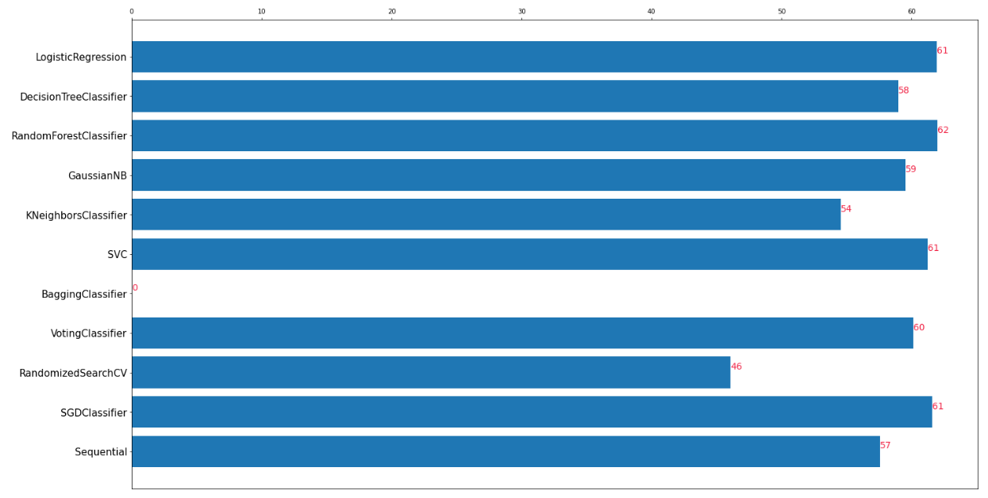
Machine Learning & Model Evaluation – F1 Score

Slide 15
Machine Learning & Model Selection
Selected Algorithm – Random Forest Classifier
Parameters for Selection:
F1 Score
Overfitting

Slide 16
References
Stack Overflow
Matplotlib
Github
Kaggle
Seaborn
Geeks for Geeks
Stack Edit
INSAID
Data Science Central
Keras API Reference
Keras Tuner Github Docs
Towards Data Science Posts
Machine Learning Mastery
Medium
YouTube
PyPi
Stack Exchange
Math Works

Slide 17
Thank You!

